Slide 1
Project Yantra
Kartik Gupta 21BCI0194
Aakash Aditya Giri 21BCI0010
Prabhav Mishra 21BCI0155
Vellore Institute of Technology, Vellore

Slide 2
Introduction to Our Team
We at Project Yantra are an ambitious team of three first-year students who strive to make innovations in the field of Internet of Things (IoT), which would further advance the supply chain management and reduce the time between the various logistical steps.

Slide 3
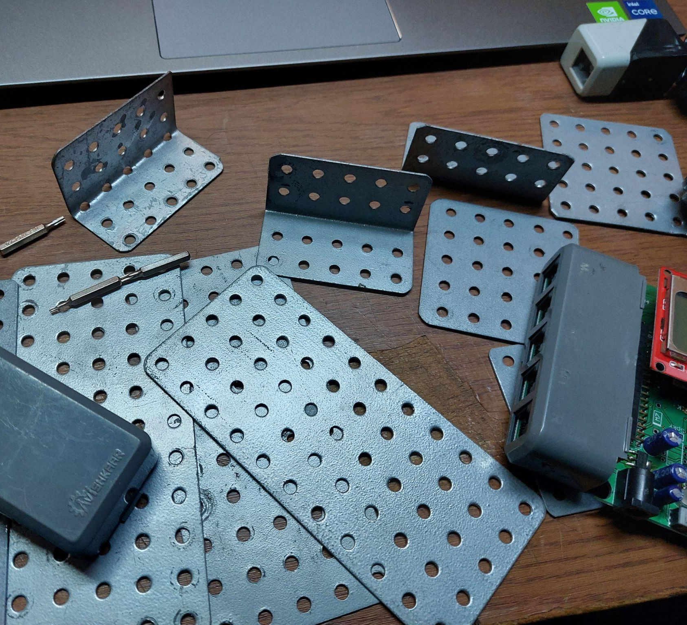
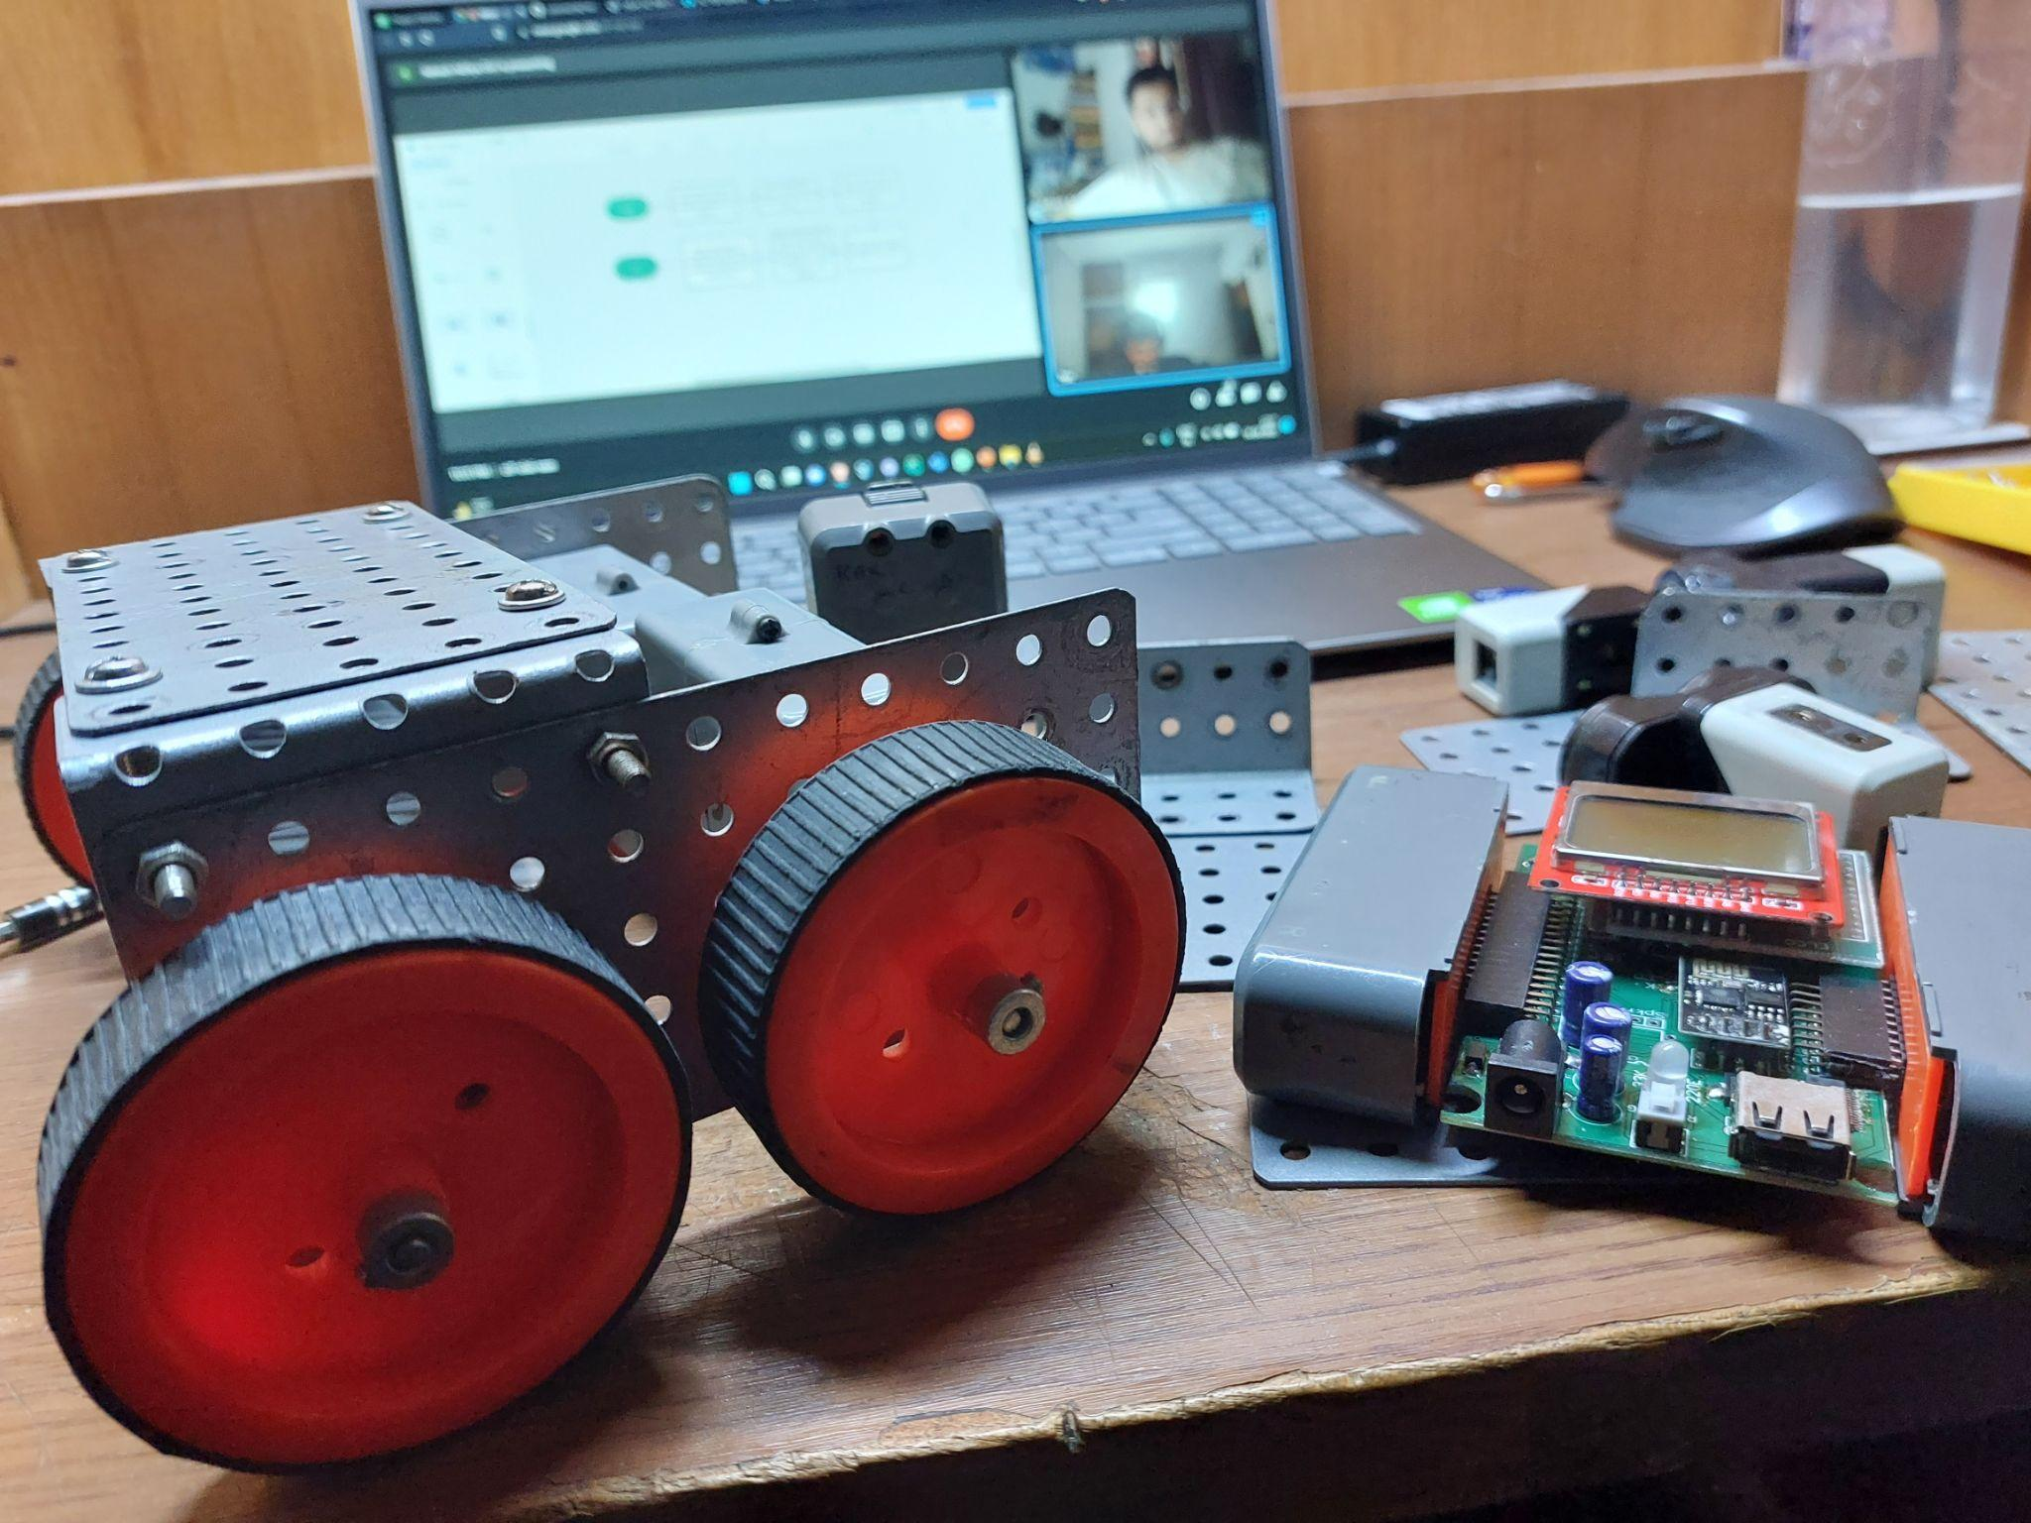
Salient Features of Our Project
Durability: It has four wheels to make it more stable and to increase the speed. Also as we have used flexi strips on the base of the robot so that the gap between the both channels remains same and hence, making it stable and durable.
Mechanism Used and Basis: Firstly, we have used the four wheeled base to increase the strength. Secondly, we have put the microcontroller vertically above the back motors so that the center of gravity is low and move faster .Thirdly, we have placed the sensors in such a way that they provide grip to the payload block.
Optimized Mechanical Design : The robot has the dimensions of 15 cm x 15 cm and has a net weight of 1.6 kg. Interestingly, the robot can carry a maximum payload of 0.6 kg. The test payload was 0.4 kg, which is 25% of the robot’s weight.

Slide 4
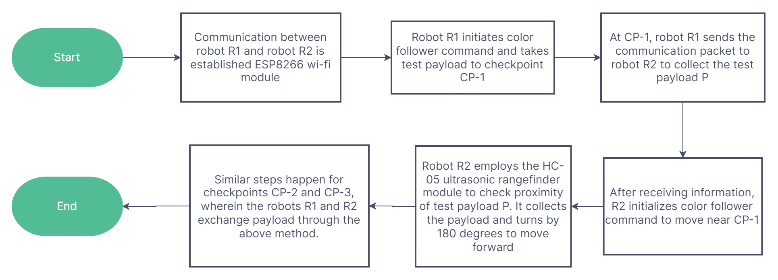
Functioning Flowchart

Slide 5
Code

Slide 6
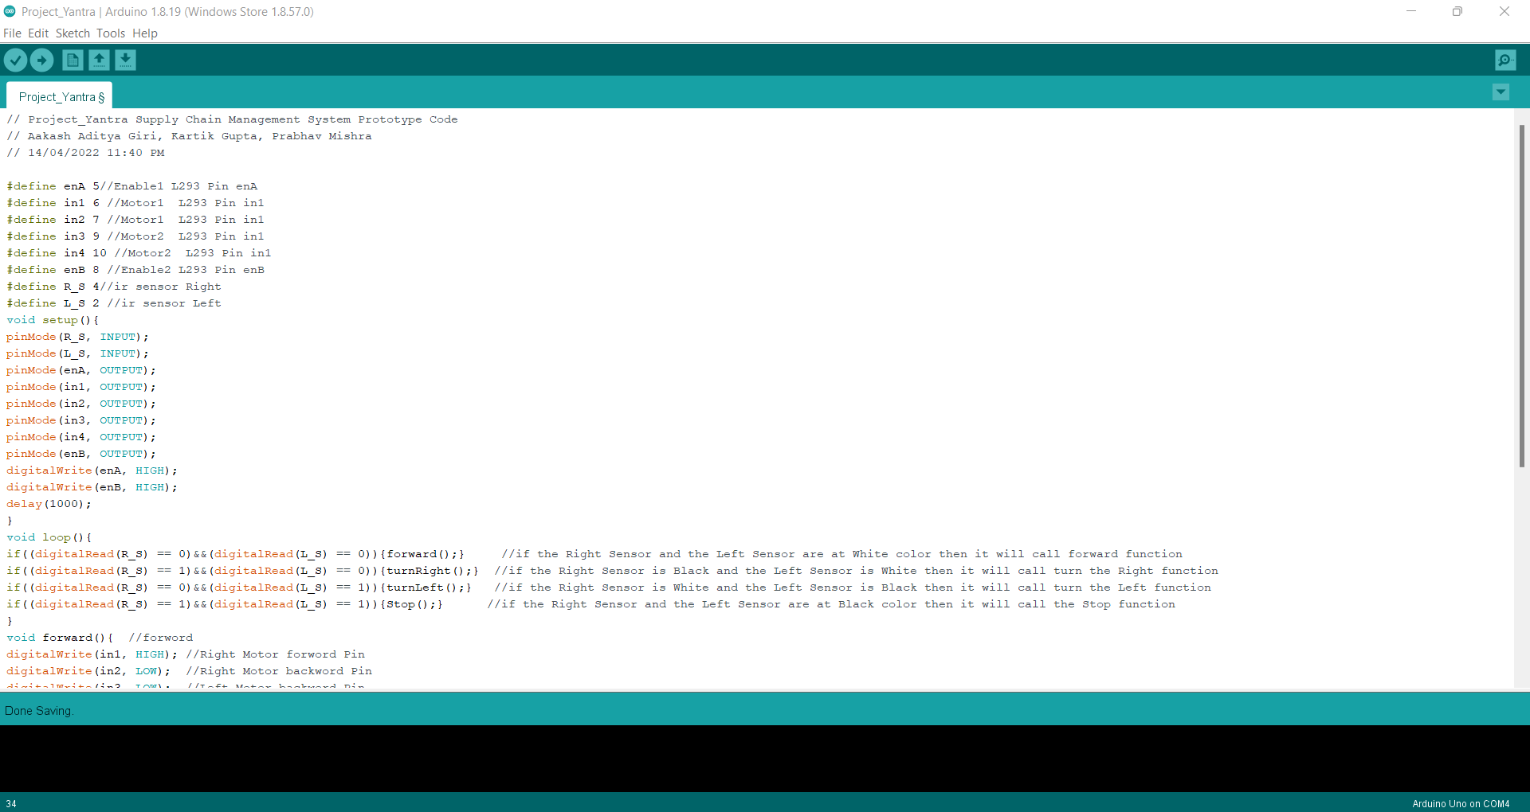
Code Development

Slide 7
Our Prototype Progress as of 8:00 AM 15/04/2022

Slide 8
